Slide 1





Philopateer
Waheed
Philopateer Waheed
Software Engineering Student | Web Developer | Freelancer
Building modern, responsive, and user-focused digital solutions.

Slide 2


About Me
I'm Philopateer Waheed, a Software Engineering student at Ahram Canadian University (ACU), Faculty of Computer Science and AI. I'm passionate about web development and freelancing, with hands-on experience building real-world projects.
I thrive on problem solving and continuous learning — constantly expanding my skill set across both frontend and backend technologies. From management systems to e-commerce platforms, I focus on delivering clean, functional, and user-focused digital solutions.
I approach every project with dedication, honesty, and a drive to grow — committed to turning ideas into practical, modern web experiences.

Slide 3


Education & Training
(2021 - Present)
(2023 - 2024)
Ahram Canadian University (ACU)
ALX Professional Foundations & Back-End
Faculty of Computer Science & AI — Software Engineering. Core focus on OOP, Data Structures, Algorithms, Database Design, and Software Engineering principles.
ALX Professional Foundations: problem-solving, professional skills & teamwork. ALX Back-End Web Development: server-side programming, APIs, and real-world backend projects.
(2023 - 2024)
(2024 - 2025)
Sprints.AI Training Programs
Black Horse Backend Development
Intensive Python training covering scripting, logic, and real-world challenges. Web Development training with hands-on practice in HTML, CSS, JavaScript, and PHP.
In-depth backend development course covering database design, application architecture, server-side logic, and building scalable, maintainable web systems.

Slide 4




My Skills
Programming Languages
Web Development
C++
95%
HTML & CSS
C#
Python
85%
JavaScript
PHP
JavaScript
80%
PHP & Laravel
Versatile multi-language
75%
MySQL
software development

Slide 5
My Skills
Software Dev Concepts
Tools
OOP
90%
Git & GitHub
Data Structures & Algorithms
Database Design
85%
XAMPP & Composer
Problem Solving
MVC Architecture
88%
VS Code & Visual Studio
CRUD Operations
80%
MySQL Workbench
Version Control

Slide 6

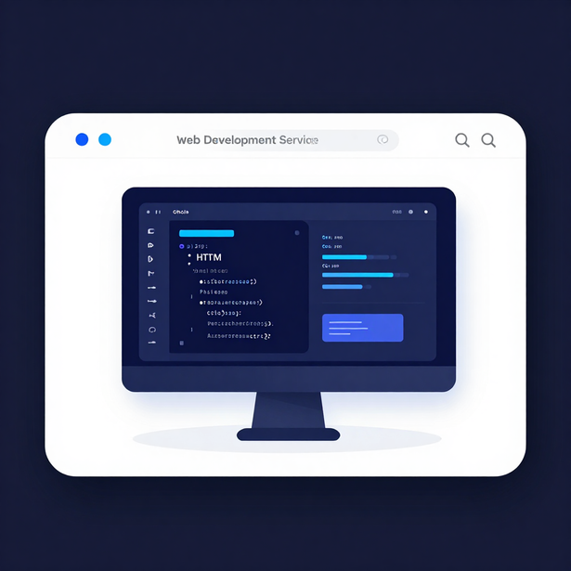
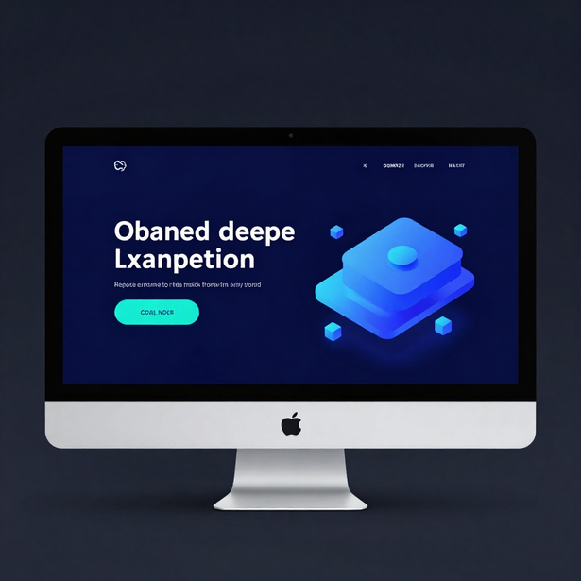
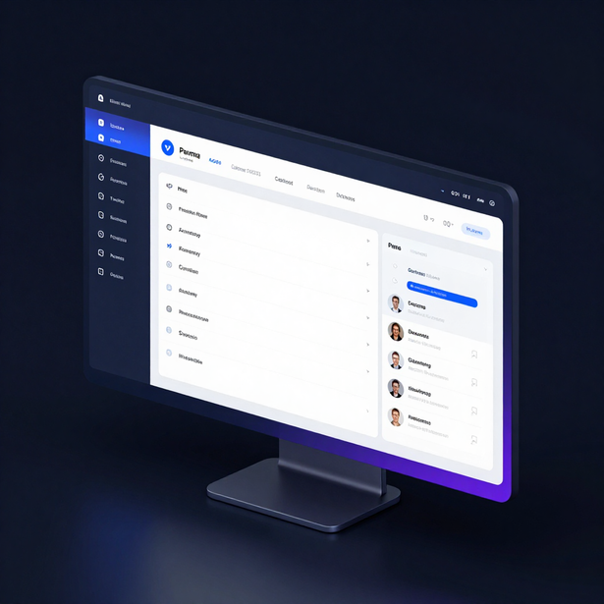


Services Offered
Web Development
Landing Pages
Web Applications

Slide 7
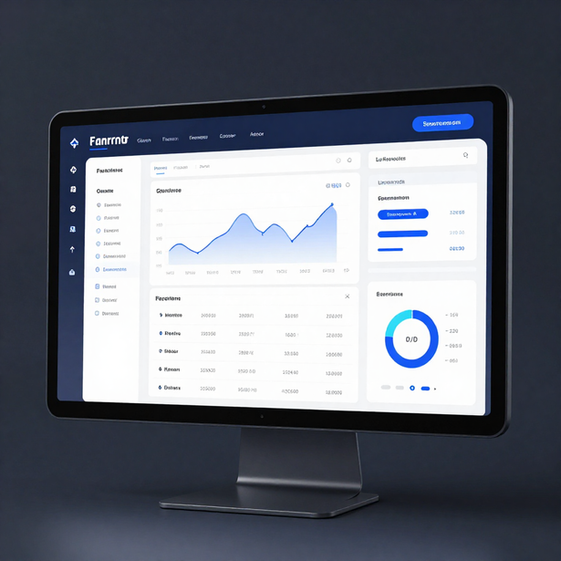
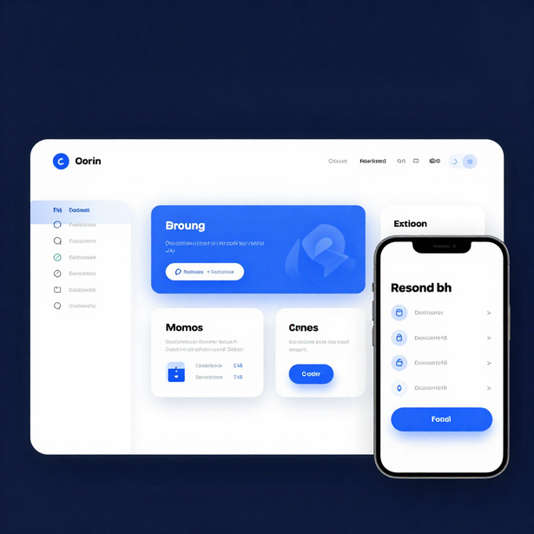
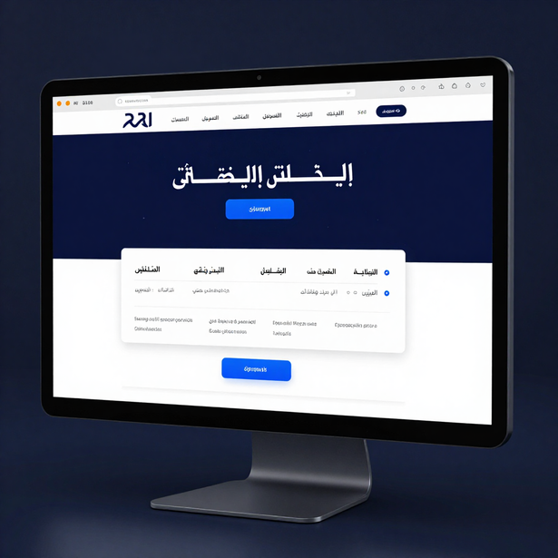
Services Offered
Dashboard Development
Front-End Development
Arabic & RTL Websites

Slide 8
Work Experience & Training
(2023 - 2024)
(2023 - 2024)
ALX Professional Foundations
ALX Back-End Web Development
Gained strong foundational skills in professional development, problem solving, and software engineering principles. Hands-on projects focused on coding logic and collaborative workflows.
Intensive backend development training covering server-side programming, APIs, and database integration. Improved coding and problem-solving through real-world project challenges.
(2024 - 2025)
(2024 - 2025)
Sprints.AI Python & Web Dev Training
Black Horse Backend Development
Intensive Python and web development training with practice on real-world programming challenges. Technologies used: Python, HTML, CSS, JavaScript, and modern development workflows.
Deep dive into backend development concepts, database design, and application architecture. Focused on PHP, MySQL, and building scalable, well-structured web application systems.

Slide 9




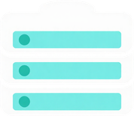

Featured Projects
Full-Stack Development
Responsive & RTL Design
Modern Web Solutions
Real-world applications built with PHP, Laravel, MySQL, and modern front-end technologies.
Delivering clean, user-friendly interfaces with Arabic RTL support and cross-device compatibility.
From school management systems to e-commerce platforms and ERP solutions built for real users.

Slide 10
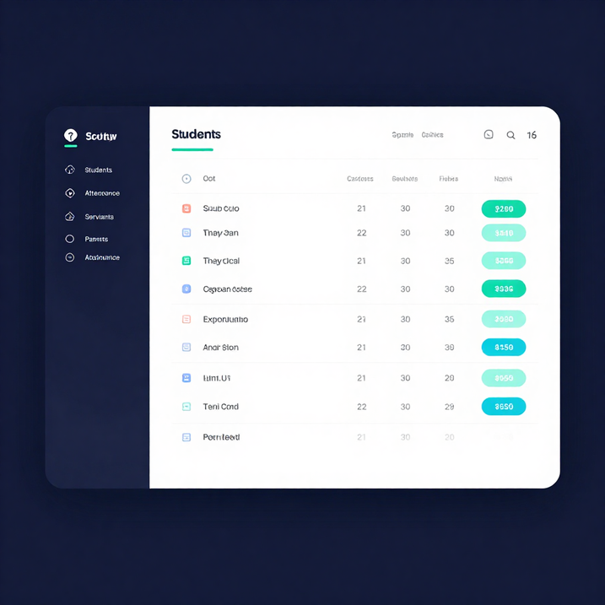
Deacons School Management System
Project Goal
Centralize management of students, servants, parents, attendance, and educational activities for a church deacons school. Built as a complete multi-role web platform with real-world functionality and user authentication.
Role, Method & Result
Full-stack developer: designed database, backend logic, UI, and management features. Stack: HTML, CSS, JavaScript, PHP, MySQL — role-based access, CRUD operations, responsive design. Result: Demonstrates ability to build complete multi-role management workflows with practical, real-world functionality.

Slide 11
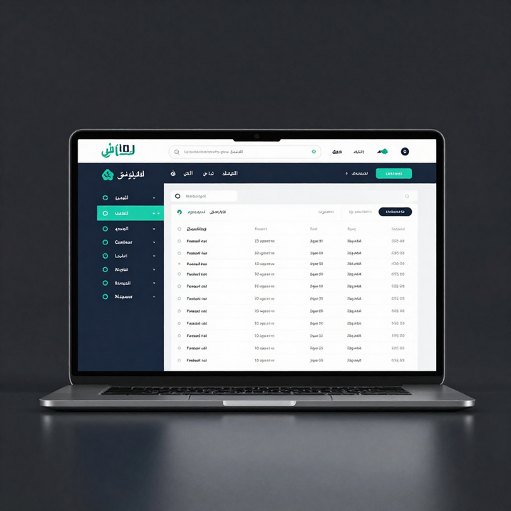
Church Management Project
Goal & Role
Develop a user-friendly church management system with full Arabic RTL support. Served as full-stack developer focusing on Arabic localization, RTL design, and responsive layout for community use.
Method & Result
Built with HTML, CSS, JavaScript, PHP, and MySQL. Features responsive Arabic RTL interface, role-based access, and CRUD operations. Demonstrates ability to build culturally appropriate, practical community solutions.

Slide 12

Laravel E-Commerce Project
Goal & Role
Build a functional e-commerce platform demonstrating Laravel skills. Served as backend and frontend developer — handling product management, user authentication, and UI design using MVC architecture, Eloquent ORM, and Blade templating.
Method & Result
Built with PHP, Laravel, MySQL, HTML, CSS, and JavaScript. Implemented scalable MVC structure, Eloquent ORM for database operations, and Blade for dynamic views. Result: Demonstrates strong Laravel proficiency and ability to build scalable, real-world web applications.

Slide 13
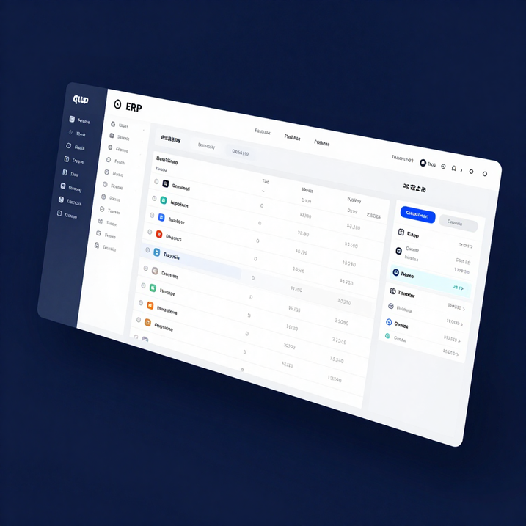
ERP / Management System
Goal & Role
Build a comprehensive system to manage business data, workflows, and operations. Designed database schema, implemented CRUD operations, and developed a clean dashboard interface for data entry and reporting.
Method & Result
Built with PHP, MySQL, HTML, CSS, JavaScript. Implements core business logic, system navigation, and structured data organization. Demonstrates understanding of enterprise-level architecture and complex data workflows.

Slide 14



Technical Presence
GitHub Profile
Project Portfolio
Code & Collaboration
Explore repositories, open-source contributions, and real-world projects showcasing hands-on development skills and coding consistency.
A curated collection of full-stack and web development projects demonstrating practical application of modern technologies and frameworks.
Version control with Git and GitHub, collaborative workflows, and clean code practices applied across all development projects.

Slide 15

GitHub Overview
Explore my repositories, projects, and development work on GitHub.
My GitHub profile showcases a growing collection of real-world projects including school management systems, church management platforms, e-commerce applications, and ERP solutions.
🔗 github.com/Philo25Waheed
From full-stack web apps to backend systems, each repository reflects hands-on problem solving, clean code practices, and continuous learning in modern web development technologies.

Slide 16





Let's Build Something Great
Email : filowaheed28@gmail.com
Phone : 01203031800
GitHub : github.com/Philo25Waheed
LinkedIn : [Add verified LinkedIn]

Slide 17

Thank You
For Your Time
Philopateer Waheed
Questions? Let's Connect.
github.com/Philo25Waheed

